Slide 1
Data Science with Deep Learning
DS101-2025-03
From dataset understanding to result presentation and how to employ deep acyclic graph models in Predictive Analytics
Lec. PhD. Eng. Andrei Ionut DAMIAN, As. Eng. Vitalii TODERIAN

Slide 2
Operational stuff
Project: assigned or based on work data decision ___
Mandatory research reviews: lists until ___
Optional research highlight: lists until ___
*see https://github.com/Ratio1/DS101-2025 for dates
Everything related to project data, mandatory research, optional research can be discussed on group / chat (Teams)

Slide 3
More operational stuff
Environment:
VSCode or PyCharm with dev-env (image: pytorch/pytorch)
(Optional) Anaconda with TensorFlow

Slide 4
Data Case Study – Pharma Industry
Purpose of data and how it looks
Track transactions
Accounting
Legal/compliance
Big Data ?
ID, CUSTOMER_ID, TRAN, PROD_ID, QTY, VALUE …

Slide 5
Data Case Study – Pharma Industry
Objectives of analysis:
Simple metrics for analyzing the underlining business
Benchmark?
Over time
Executive decisions
BEST: Actionable insights!

Slide 6
Data Case Study – Pharma Industry
Observations separation
Fundamental question: “What makes tick …”
How can we measure the pharma customers
Vertical vs horizontal
Simple approach

Slide 7
Data Case Study – Pharma Industry
Preprocessing – from transactional data to actual variables
RFM
Other features
NLP ?

Slide 8
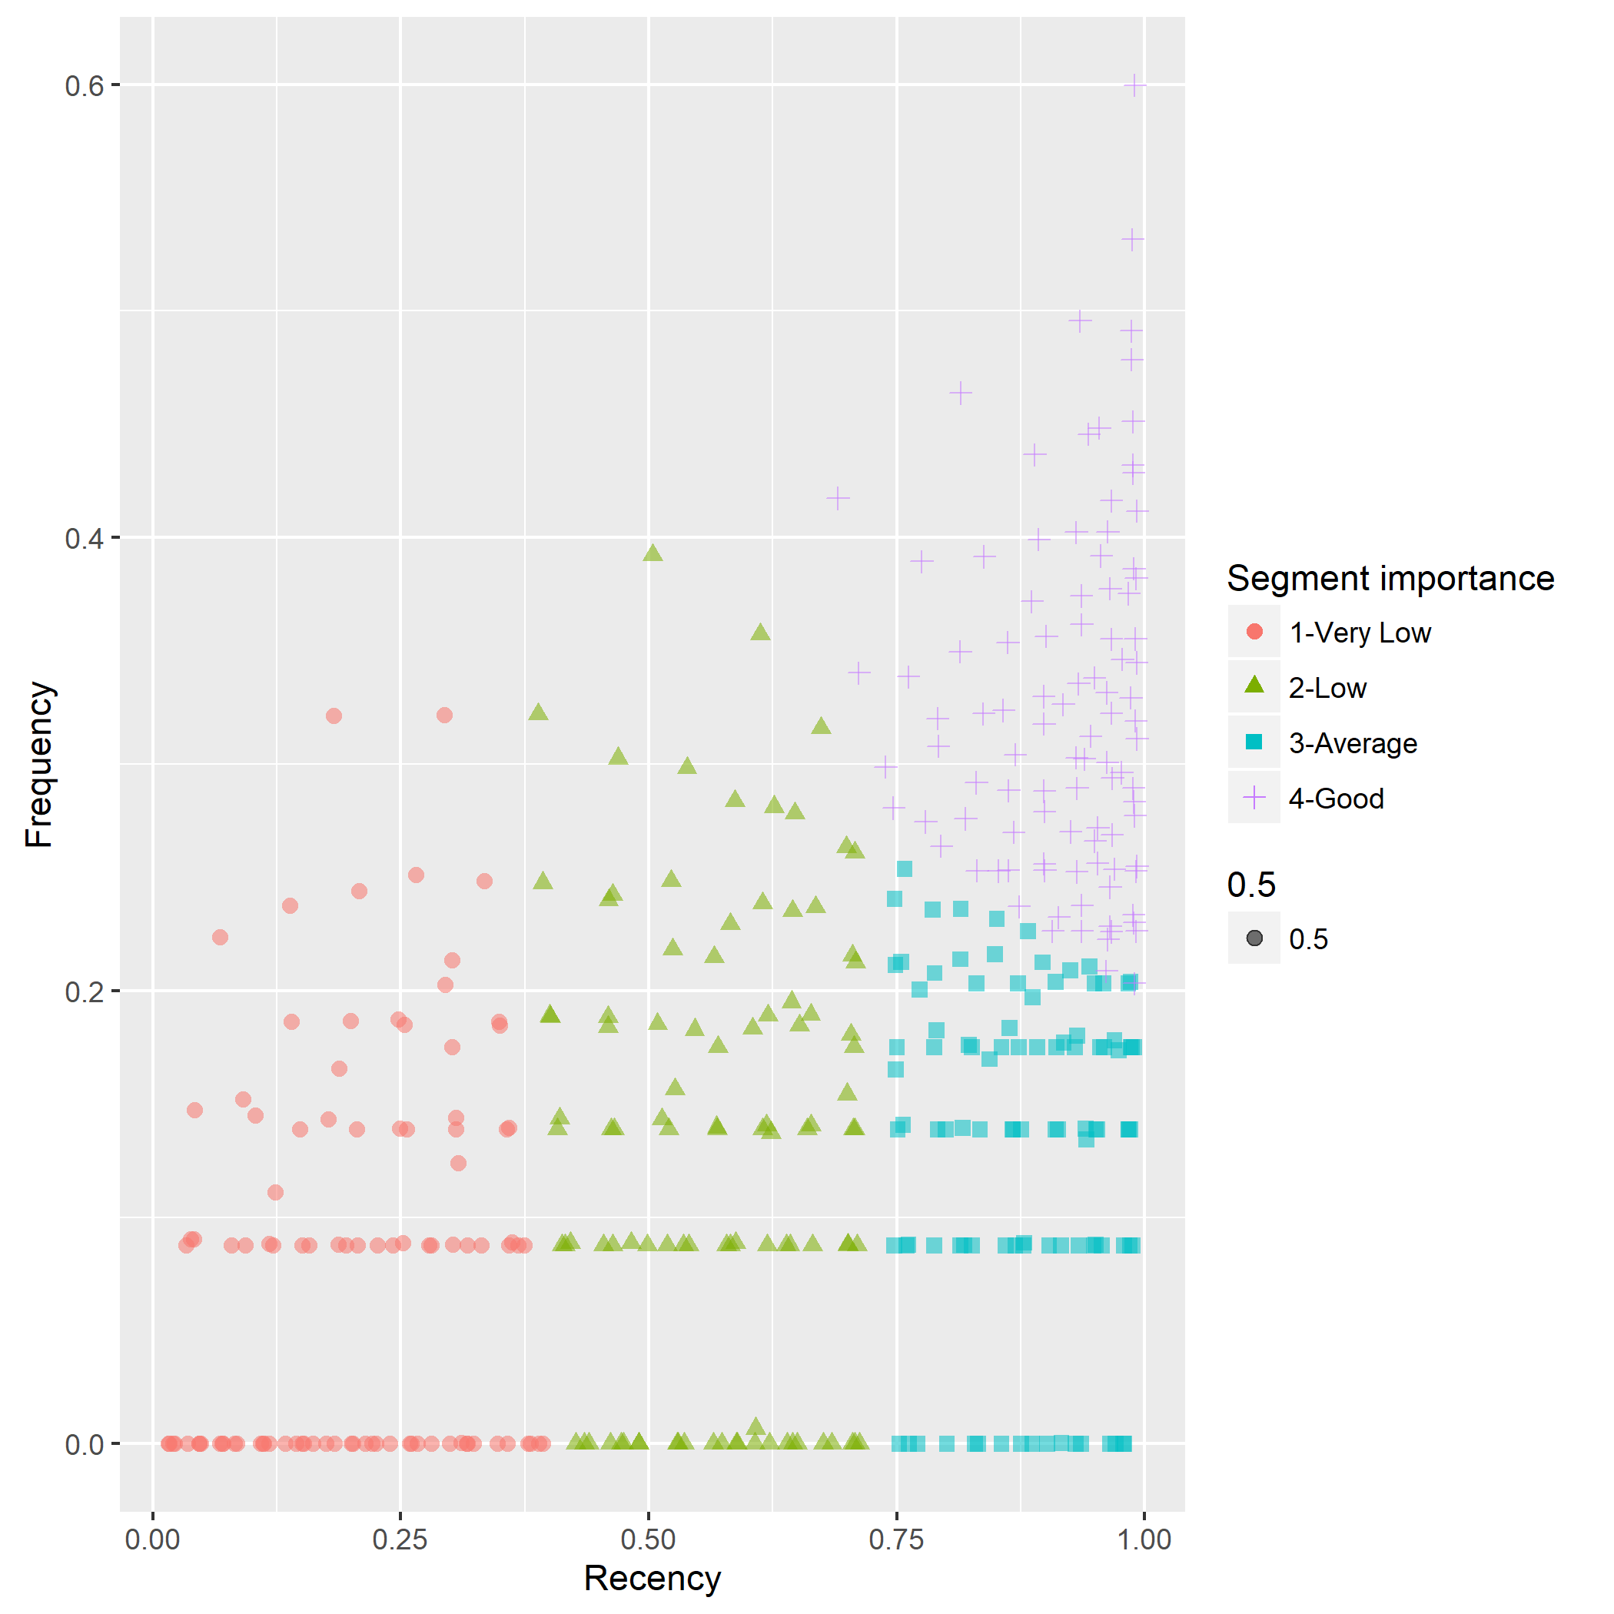
Basic Machine Learning – Pharma Industry
2D Plot of FR from RFM clustering

Slide 9
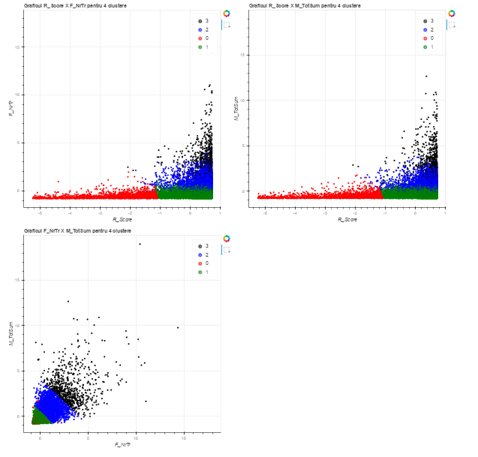
Data Case Study – Pharma Industry

Slide 10
Basic Machine Learning – Pharma Industry
Clustering
Finally some Machine Learning: kMeans
Curse of dimensionality? Use t-SNE visualization!
Do we need dimensionality reduction?
How can we actually get valuable information

Slide 11
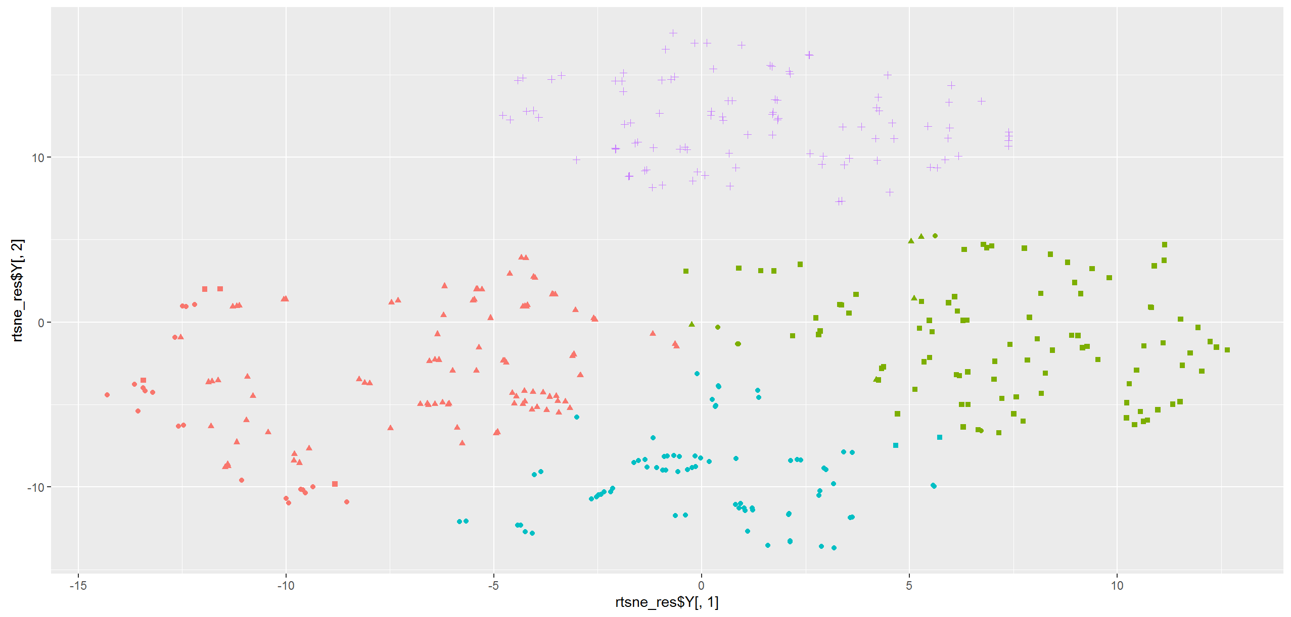
Basic Machine Learning – Pharma Industry
T-SNE projection of the clustering results

Slide 12
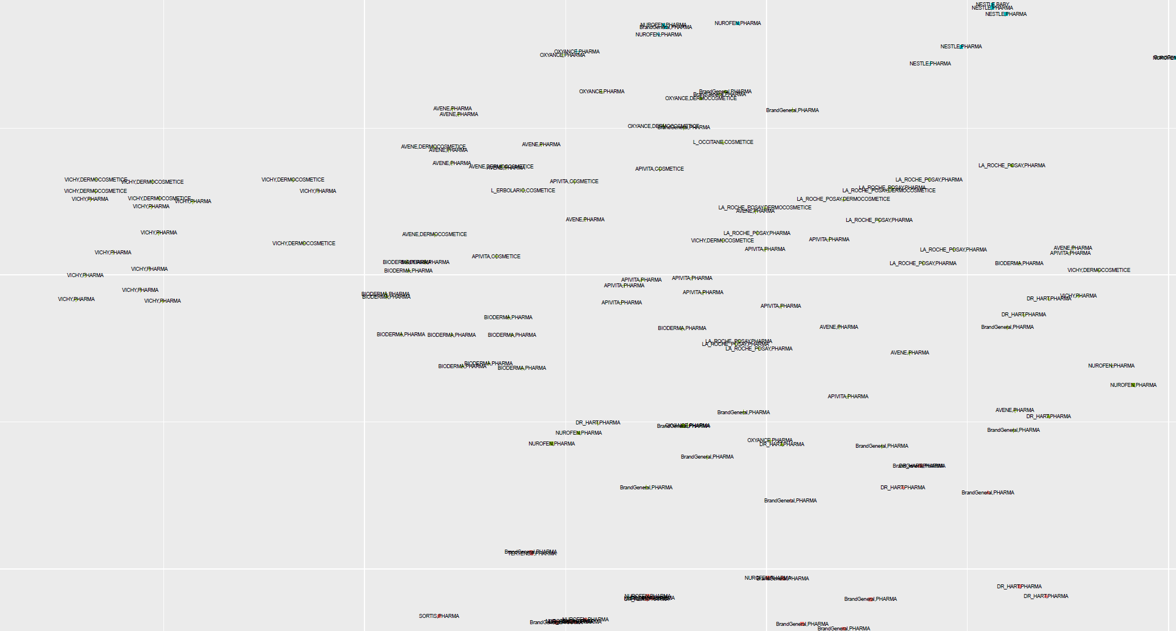
Visualization with augmented t-SNE

Slide 13
Basic Machine Learning – Pharma Industry
Baseline recommender
Regression time!
You get what you engineer…
Get more features – Can we “mine” text data ?

Slide 14
Basic Machine Learning – Pharma Industry
Hands-on Experiment:
Regression for imobiliare.ro basically the same as for a buying propensity prediction system (pharma recommender)

Slide 15
Basic Machine Learning – Pharma Industry
More feature engineering..
Business Text Corpus
Tokenization
Top features
Retrain
Validate

Slide 16
Engineered features and modeling on them
Project – Real estate revisited!
Add more features
Location
…?
TensorFlow
Keras
Sklearn
Compare!

Slide 17
Neural Embeddings
Next level of feature engineering
Get secondary results out of your training process
DAG-only
Word2Vect
Visualization t-SNE

Slide 18
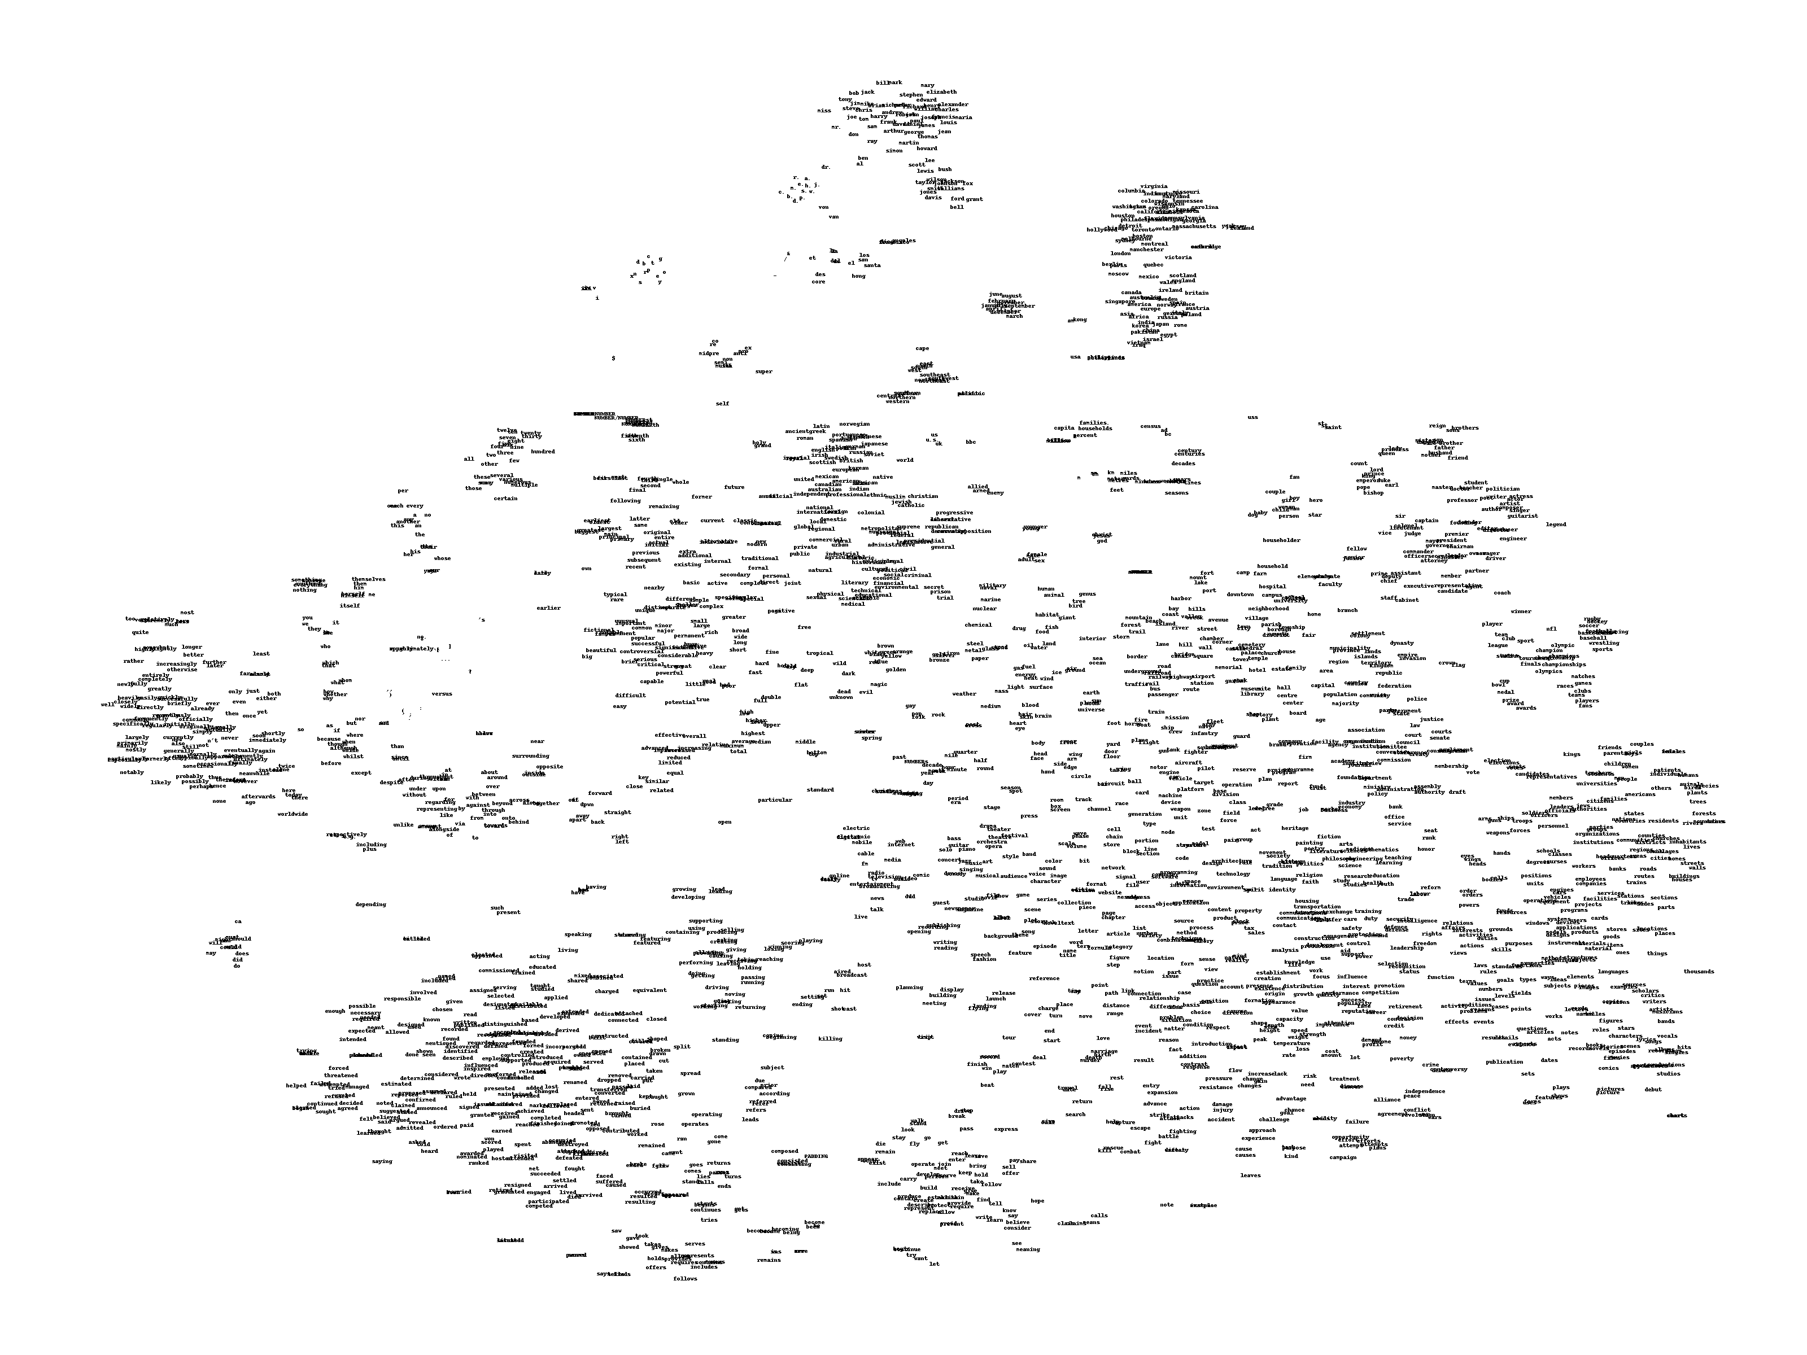
Neural Embeddings

Slide 19
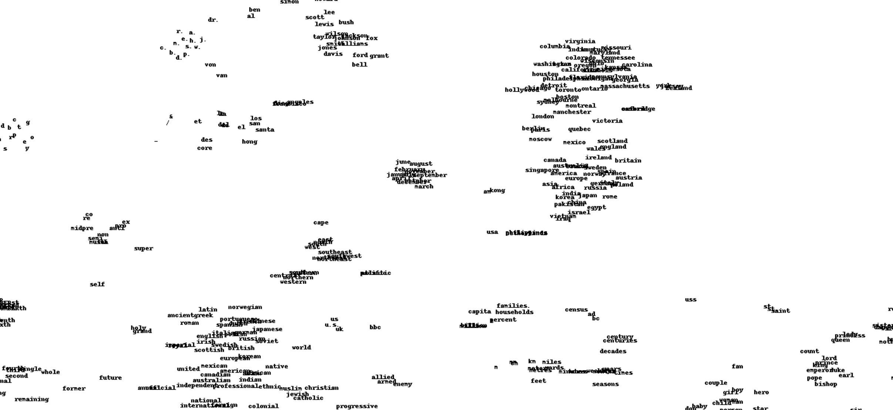
Neural Embeddings

